Slide 1
Unified Wine & Grape Symposium
State of the Industry
Supply Side Analysis
Nat DiBuduo
Allied Grape Growers
January 29, 2014

Slide 2
Today’s presentation utilizes information obtained via Allied Grape Growers’ (AGG) annual Nursery Survey combined with critical evaluation of reports and data made available by the State of California. Wine shipment data is courtesy of the Gomberg Fredrikson Report. AGG’s internal operations data along with numerous pieces of anecdotal evidence was also used in the formulation of conclusions.

Slide 3
Answering Some Key Industry Questions…….

Slide 4
Answering Some Key Industry Questions
Question #1:
How did the 2013 crush size up?

Slide 5
Answering Some Key Industry Questions
How did the 2013 crush size up?
A regional look at production, stated in tons crushed
Estimating 11% over the four-year production average,
but only about 4% over the four-year average yield for the state.

Slide 6
Answering Some Key Industry Questions
How did the 2013 crush size up?
California Production

Slide 7
Answering Some Key Industry Questions
Question #1:
How did the 2013 crush size up?
Answer:
Large, compared to recent average production, but only slightly above average when only considering yield.

Slide 8
Answering Some Key Industry Questions
Question #2:
How many acres do we really have?

Slide 9
Answering Some Key Industry Questions
How many acres do we really have?
Notes: 2013 state data will be released in April of 2014.
DPR data may include raisin variety acreage classified as wine.

Slide 10
Answering Some Key Industry Questions
How many acres do we really have?

Slide 11
Answering Some Key Industry Questions
Question #2:
How many acres do we really have?
Answer:
Much more than the state has historically reported or estimated

Slide 12
Answering Some Key Industry Questions
Question #3:
Is the market balanced now?

Slide 13
Answering Some Key Industry Questions
Is the market balanced now?
Inventory long, then balancing, then short and back to balance
Working thru inventory
Recession
Short crop/recovery

Slide 14
Answering Some Key Industry Questions
Question #3:
Is the market balanced now?
Answer:
Yes. There is no wine shortage.

Slide 15
Answering Some Key Industry Questions
Question #4:
What are growers planting today?
(other than almonds)

Slide 16
Answering Some Key Industry Questions
What are growers planting today?
29% White
71% Red
Other Reds Include:
Grenache
Cab Franc
Syrah
Malbec
Tannat
Other Whites Include:
Gewurztraminer
Riesling
Viognier
Other florals
Notes:
Say:
We reverted back to our pattern of planting red winegrapes over white, after last years switch due to heavy Muscat vine sales.
Note Malbec and Petite Sirah significance and the assortment of other reds. Fairly diverse planting overall.

Slide 17
Answering Some Key Industry Questions
Question #4:
What are growers planting today?
(other than almonds)
Answer:
Cabernet Sauvignon….
and a few other varieties

Slide 18
Answering Some Key Industry Questions
Question #5:
What are today’s issues?

Slide 19
Answering Some Key Industry Questions
What are today’s issues?
Grower Issues:
  Water
  The Market & Contracts
    Max tons/quality/terms
  Scheduling/Delivery
    Hang-time
  Vine Diseases/Pests
    Impact on suitability
  Labor
    Mechanization
  Sustainability
Industry Issues:
  Water
  California Promotion
    Marketing order?
  Capacity
    Fermentation/Storage
  Research & Investment
    Upcoming PD vote
  Legislation/Regulation
    Air, labor, water, etc.
  Sustainability

Slide 20
Answering Some Key Industry Questions
Question #6:
What about the drought?

Slide 21
Answering Some Key Industry Questions
What about the drought?

Slide 22
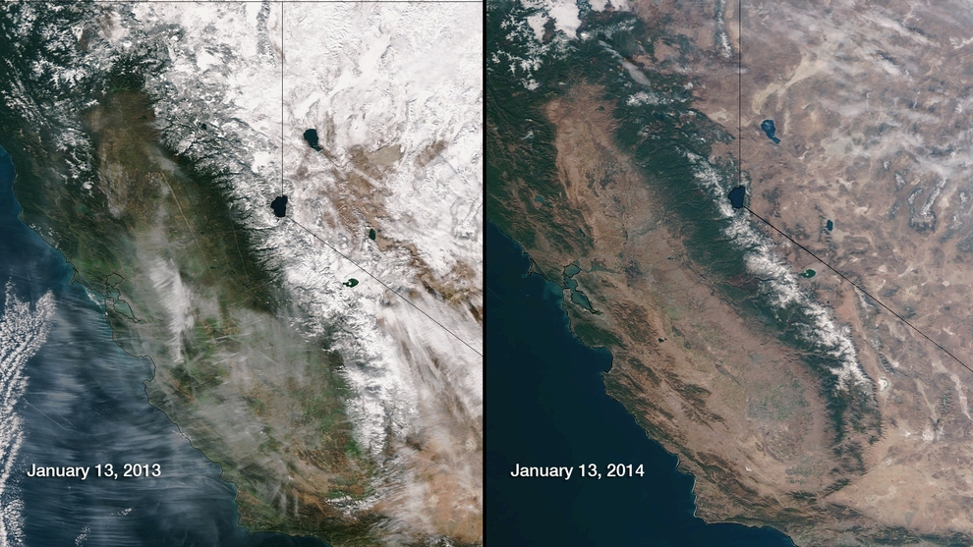
Answering Some Key Industry Questions
What about the drought?

Slide 23
Answering Some Key Industry Questions
What about the drought?
Drought impacts different regions in different ways:
  North Coast
  Central Coast
  Northern San Joaquin Valley (Lodi)
  Central and Southern San Joaquin Valley (east side)
  Central and Southern San Joaquin Valley (west side)
Notes:
Say:
Note that Cabernet Sauvignon has made the top two for the last four years.

Slide 24
Answering Some Key Industry Questions
What about the drought?
Viticulturally, what does it mean for 2014 and beyond?
  Functional root zone reduction (root flush minimized)
  Potential for bud necrosis
  Restricted spring growth
  Nutrient deficiencies and/or toxicities
  Potential lack of frost protection
  Vine stress, increased pest and disease pressure
  Water quality concerns
  Potential canopy/crop load reduction

Slide 25
Answering Some Key Industry Questions
Question #7:
Will our domestic supply depress import growth?

Slide 26
Answering Some Key Industry Questions
Will our domestic supply depress import growth?

Slide 27
Answering Some Key Industry Questions
Will our domestic supply depress import growth?

Slide 28
Answering Some Key Industry Questions
Will our domestic supply depress import growth?

Slide 29
Answering Some Key Industry Questions
Will our domestic supply depress import growth?

Slide 30
Answering Some Key Industry Questions
Will our domestic supply depress import growth?

Slide 31
Answering Some Key Industry Questions
Will our domestic supply depress import growth?

Slide 32
Answering Some Key Industry Questions
Will our domestic supply depress import growth?

Slide 33
Answering Some Key Industry Questions
Question #7:
Will our domestic supply depress import growth?
Answer:
Yes. Based on market behavior in the recent past, it should.

Slide 34
Answering Some Key Industry Questions
Question #8:
What are the regional planting trends?

Slide 35
Answering Some Key Industry Questions
What are the regional planting trends?
A high percentage of the “Value” plantings are in Lodi
Notes:
Say:
High end of the market is mainly Napa/Sonoma and Santa Barbara.
Mid Range is all other coastal areas
Value segment of the market is the interior (INCLUDING LODI)
Aside from Valley varieties, Muscat and Colombard, the trend in 2012 was to purchase vines for planting in coastal districts.

Slide 36
Answering Some Key Industry Questions
What are the regional planting trends?
Varieties charted are Chardonnay, Cabernet Sauvignon, Merlot, Pinot Noir and Zinfandel.
Notes:
Say:
High end of the market is mainly Napa/Sonoma and Santa Barbara.
Mid Range is all other coastal areas
Value segment of the market is the interior (INCLUDING LODI)
Aside from Valley varieties, Muscat and Colombard, the trend in 2012 was to purchase vines for planting in coastal districts.

Slide 37
Answering Some Key Industry Questions
Question #8:
What are the regional planting trends?
Answer:
Coastal planting of major varietals has increased substantially. Interior planting has shifted north to Lodi.

Slide 38
Answering Some Key Industry Questions
Question #9:
Are we headed for surplus,
balance or shortage?

Slide 39
Answering Some Key Industry Questions
Are we headed for surplus, balance or shortage?
Average Statewide Yield = 7.17 TPA
Assumes no escalation in the current rate of annual vineyard removals…….
(<2% per year).
Notes:
Say:
Based on the average yield from 2005-2012, as well as projected statewide bearing winegrape acreage, we have estimated the total amount of potential winegrapes for crush from 2013-2016.

Slide 40
Answering Some Key Industry Questions
Are we headed for surplus, balance or shortage?
Grapes crushed for wine, NOT winegrapes crushed.
Average difference = 220,000+ tons
Notes:
Say:
Based on the average yield from 2005-2012, as well as projected statewide bearing winegrape acreage, we have estimated the total amount of potential winegrapes for crush from 2013-2016.

Slide 41
Answering Some Key Industry Questions
Are we headed for surplus, balance or shortage?
Forecast shows production growth outpacing shipments in the near future
Notes:
Say:
Based on the average yield from 2005-2012, as well as projected statewide bearing winegrape acreage, we have estimated the total amount of potential winegrapes for crush from 2013-2016.

Slide 42
Answering Some Key Industry Questions
Are we headed for surplus, balance or shortage?
Forecast shows acreage growth beginning to outpace the trendline by 2017.

Slide 43
Answering Some Key Industry Questions
Question #9:
Are we headed for surplus,
balance or shortage?
Answer:
We are not forecasting a shortage
in the foreseeable future

Slide 44
Final Thoughts
The future looks bright for California and American grown grapes and wine but, as always, we need to be cautious and plan diligently to match future growth potential.
The opportunity for grower and winery profitability stays with us. A balanced supply will underwrite the ability for all in the business to continuously achieve profitability.
Sustainability continues to be an industry priority. We all need to work together to assure the success of our industry, our workforce, our communities and the reasonable protection of our environment; but most of all we have to stay focused on those things that create economic sustainability.

Slide 45
For more information
come see us at
Booth 727
Or visit us at:
alliedgrapegrowers.org

